Slide 1
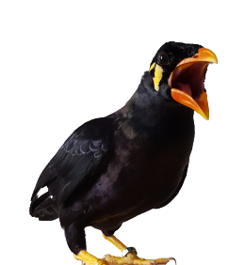
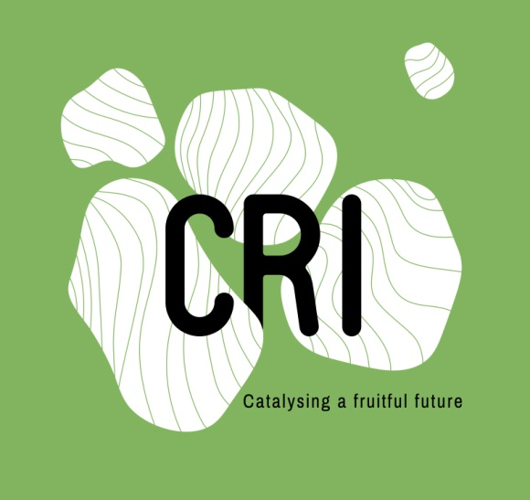
INTERNSHIP DEFENSE
Author : Irina DELAMARE Supervisor : Pauline PROVINI
MORPHO-FUNCTIONAL STUDY OF BIRDS VOCAL SYSTEM:
INFLUENCE OF THE PHYLOGENY, SIZE AND NOCTURNALITY ON ACOUSTIC PARAMETERS
01/09/2020 To 31/12/2020
Notes:
I just want to precise that the animation of this slide takes a big part of the comprehention of this presentation. So if you are not looking at my screen sharing, please still use the Present buton to follow my talk.
So, I am Irina

Slide 2

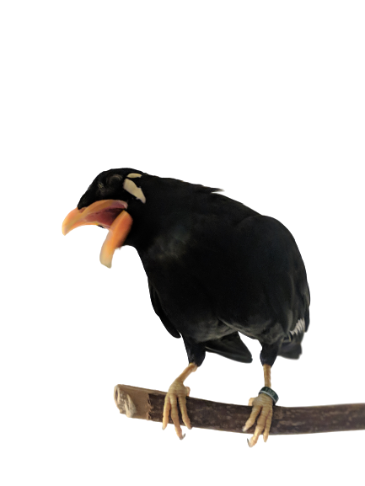
1
5
Context and Background
Conclusion and perspectives
2
Introduction
6
Acknowledgments
SUMMARY
3
Material and Methods
4
Results and discussion
Notes:
I am going to walk you through the background of the Birdsong Team and set the context to bird song research.

Slide 3




Context and Background
1
Pauline Provini
Rachel Olson
Alireza Kazemi
“The goal of our lab is to understand the mechanisms by which birds are producing vocalisations. One application of our research is to produce bio-inspired vocal prostheses to improve the voice quality of people with laryngectomies.”
Pauline Provini,
Long term fellows at CRI
Notes:
My work focused on the way birds are producing vocalisation.
Rachel Olson : Identify what shape is associated with what sounds, she will test for correlations between the vocal system 3D shape using X-ray microtomography (µCT) with contrast agent and sound parameters in order to link the anatomy of the avian vocal system (the syrinx) with the sounds they produce.
Alireza Kazemi : built an aero-acoustic model of bird sound production to focus on the airflow, which is at the origin of the sound production.

Slide 4
Introduction
2

Slide 5
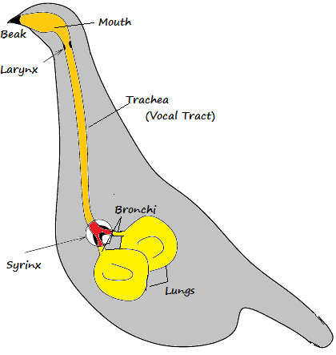
They produce sounds with their SYRINX
How do birds vocalize ?
They modulate the sounds with their VOCAL TRACT
https://medium.com/@IckeIlknur/central-pattern-generators-to-synthesize-birdsongs-f0d09d6936c0
Notes:
Have you ever wonder how do birds vocalise? There are 2 essentials things to consider while studying the vocalization process in any species! Indeed, most animals have the ability to produce and to modulate sounds. Humans for example produce sounds with their vocal folds in the larynx, and then articulate the produced sound into words using their mouth, tongue, lips.
In birds, the primary sound is produced by the vibration of the membranes of the syrinx and is then modulated by the vocal tract.
schem, def vocal tract
Because most research focuses on the production of sound by the syrinx, modulations by the vocal tract have been overlooked for a long time. That is what the Bird song team is focusing on.

Slide 6
They produce sounds with their SYRINX
How do birds vocalize ?
They modulate the sounds with their VOCAL TRACT
Does it depends on :
Introduction
Evolutionary history
Shape
Body size
Motion and deformation
Life style
Airflow
Ames PL. The Morphology of the Syrinx in Passerine Birds. 1971
Gaunt AS, Gaunt SLL. Syringeal Structure and Avian Phonation. 1985
Suthers RA. Contributions to birdsong from the left and right sides of the intact syrinx. 1990
Goller F, Larsen ON. In situ biomechanics of the syrinx and sound generation in pigeons. 1997
Riede T, Goller F. Functional morphology of the sound-generating labia in the syrinx of two songbird species. 2010
Ibrahim IA-A, Hussein MM. Comparative Morphological Features of Syrinx in Male Domestic Fowl Gallus gallus domesticus and Male Domestic Pigeon Columba livia domestica. 2020
Notes:
what parameters influence the sound?
evolutionary history, shape and body size, lifestyle, shape and deformation and air flow to understand the biomechanic of vocalisation
Because the shape of the syrinx has already been much studied, and because the motion and deformation, and the airflow are being studied by the postdocs,I will focus on ...

Slide 7
They produce sounds with their SYRINX
How do birds vocalize ?
They modulate the sounds with their VOCAL TRACT
Does it depends on :
Introduction
Evolutionary history
Shape
Body size
Motion and deformation
Life style
Airflow
Notes:
I have worked on life style but, due to lack of time, will not present my results here

Slide 8

Material and Methods
3

Slide 9
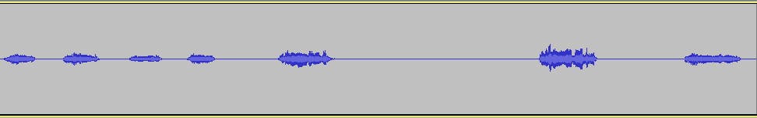
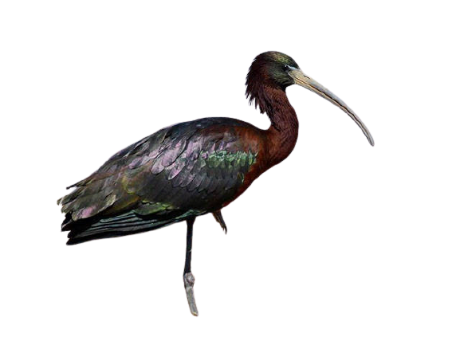
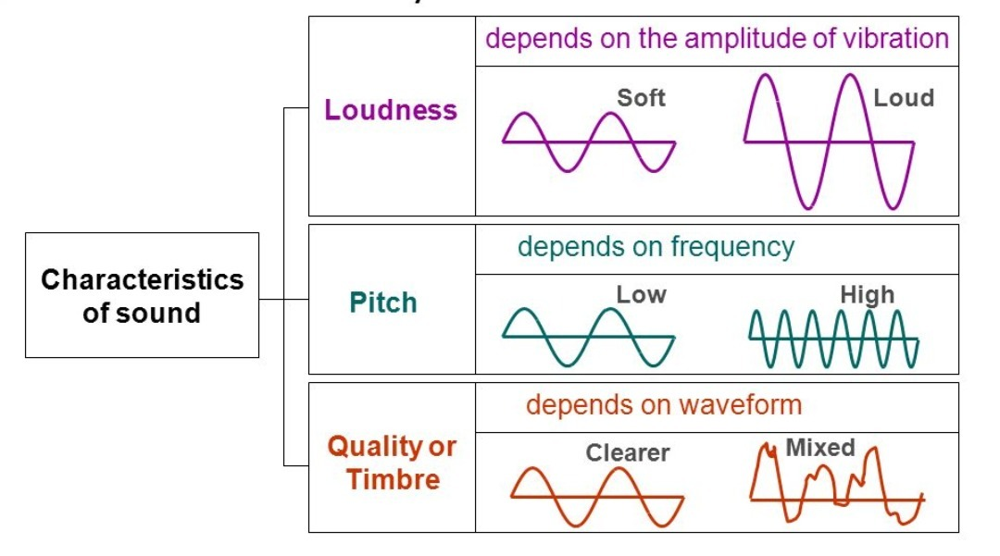
Spectrogram of Plegadis falcinellus
130 Recordings
Mean, Min, and Max Pitch, Loudness ...
Notes:
I gathered a total of 130 recordings each from different species. From each recordings, I extracted multiple parameters such as the mean, min, max pitch and loudness.
As a quick recap, …
Here you can see an example of one spectrogram from the recording of Plegadis falcinellus. On this recording, to give you an idea, I removed background noises and then extracted acoustic parameters such as the loudness, pitch and timbre.
Having these data, I wondered if phylogeny could predict those acoustic parameters.

Slide 10
They produce sounds with their SYRINX
How do birds vocalize ?
They modulate the sounds with their VOCAL TRACT
Does it depends on :
Introduction
Evolutionary history
Body size
Life style
Questions
Quantification with exploration of sound production in different families of birds
Influence of body size on sound parameters
Relationship between sound production and nocturnality
Notes:
So, I will quantify sound production in different order of birds to look at the relation between birds evolutionary history and the produce sounds. I will look at the influence of body size on sound parameters. I will also look at the relationship between nocturnality and sound production.

Slide 11

Results and Discussion
4
Notes:
Can we determine acoustic parameters from certain variables?

Slide 12
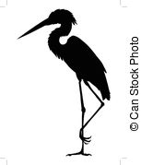
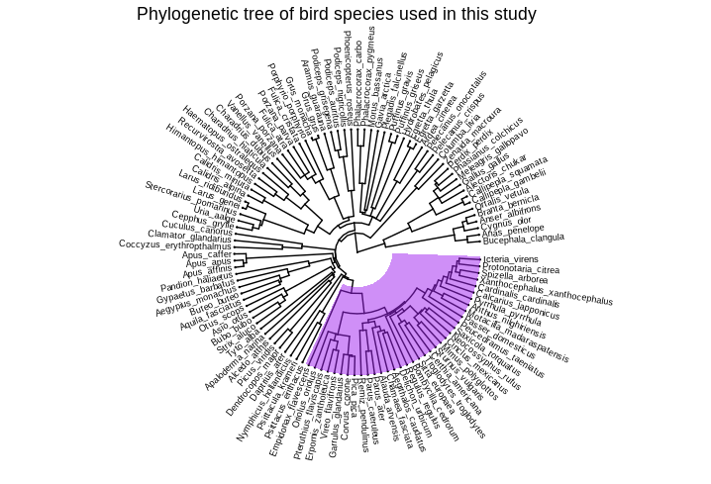
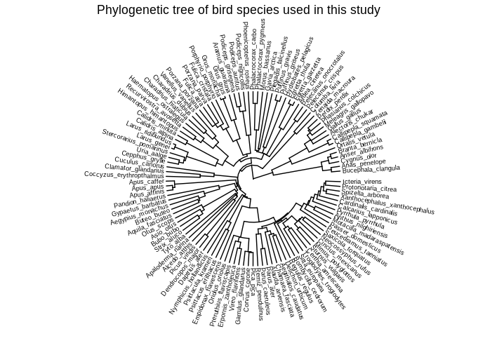

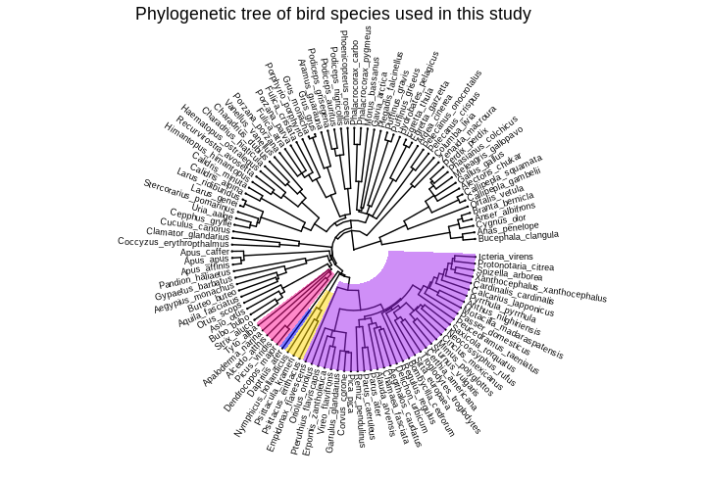
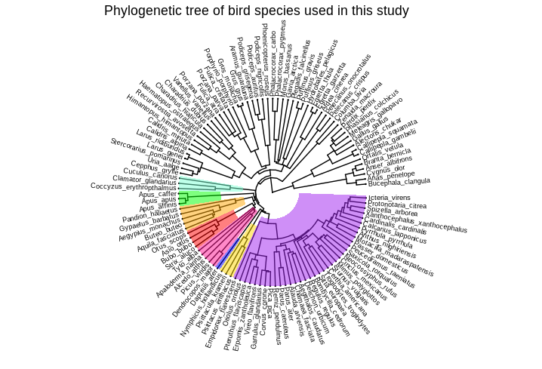
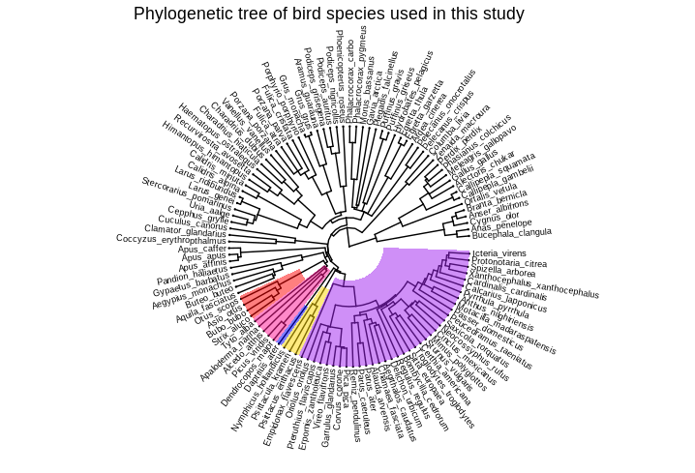
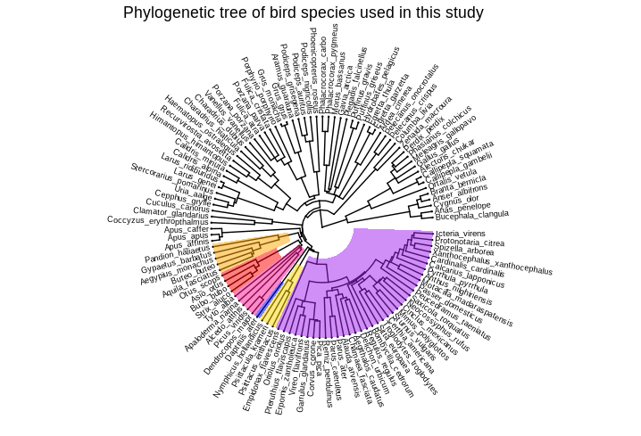
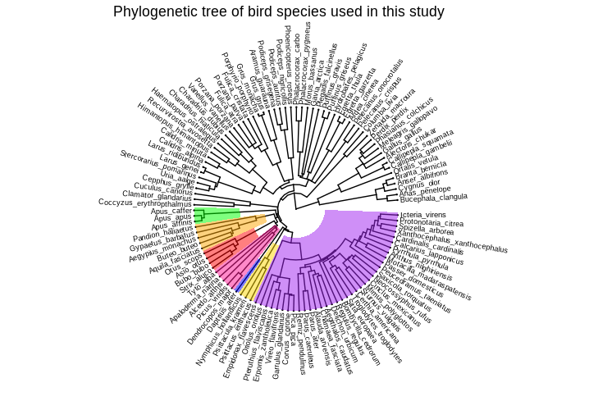

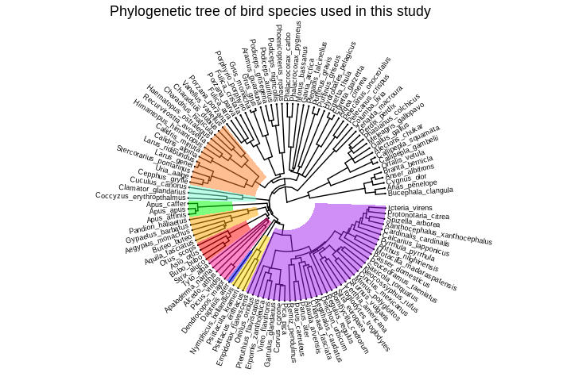
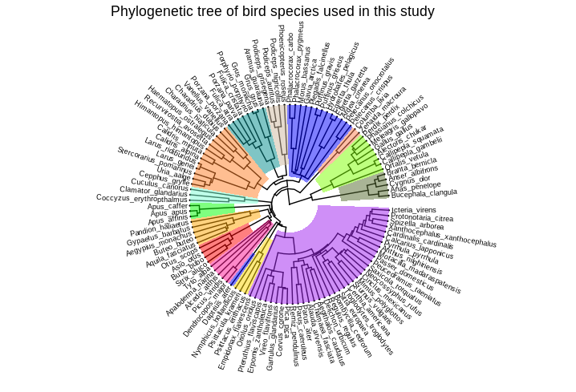
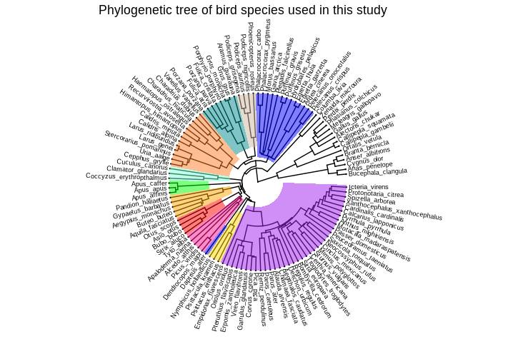
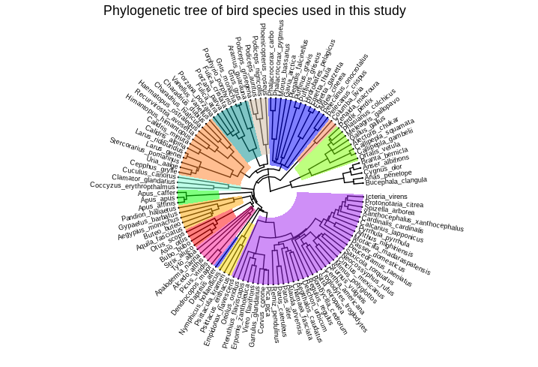
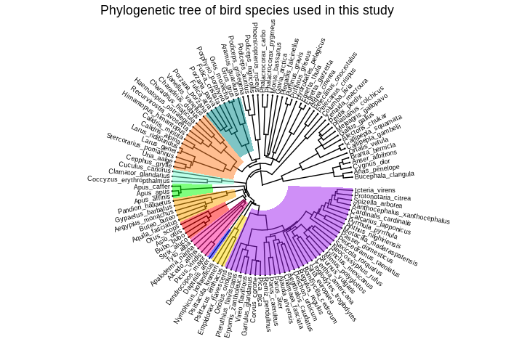

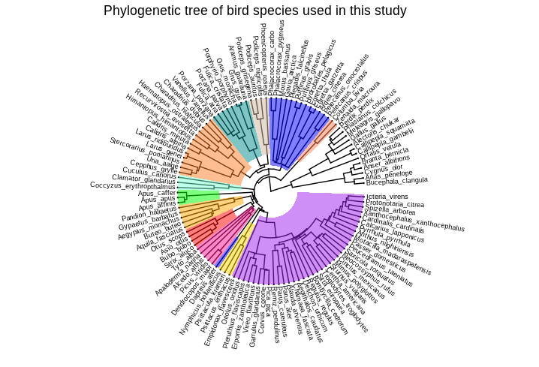
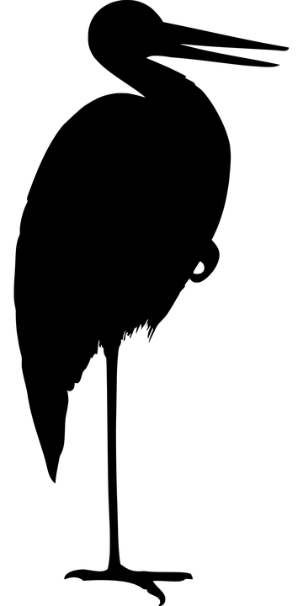
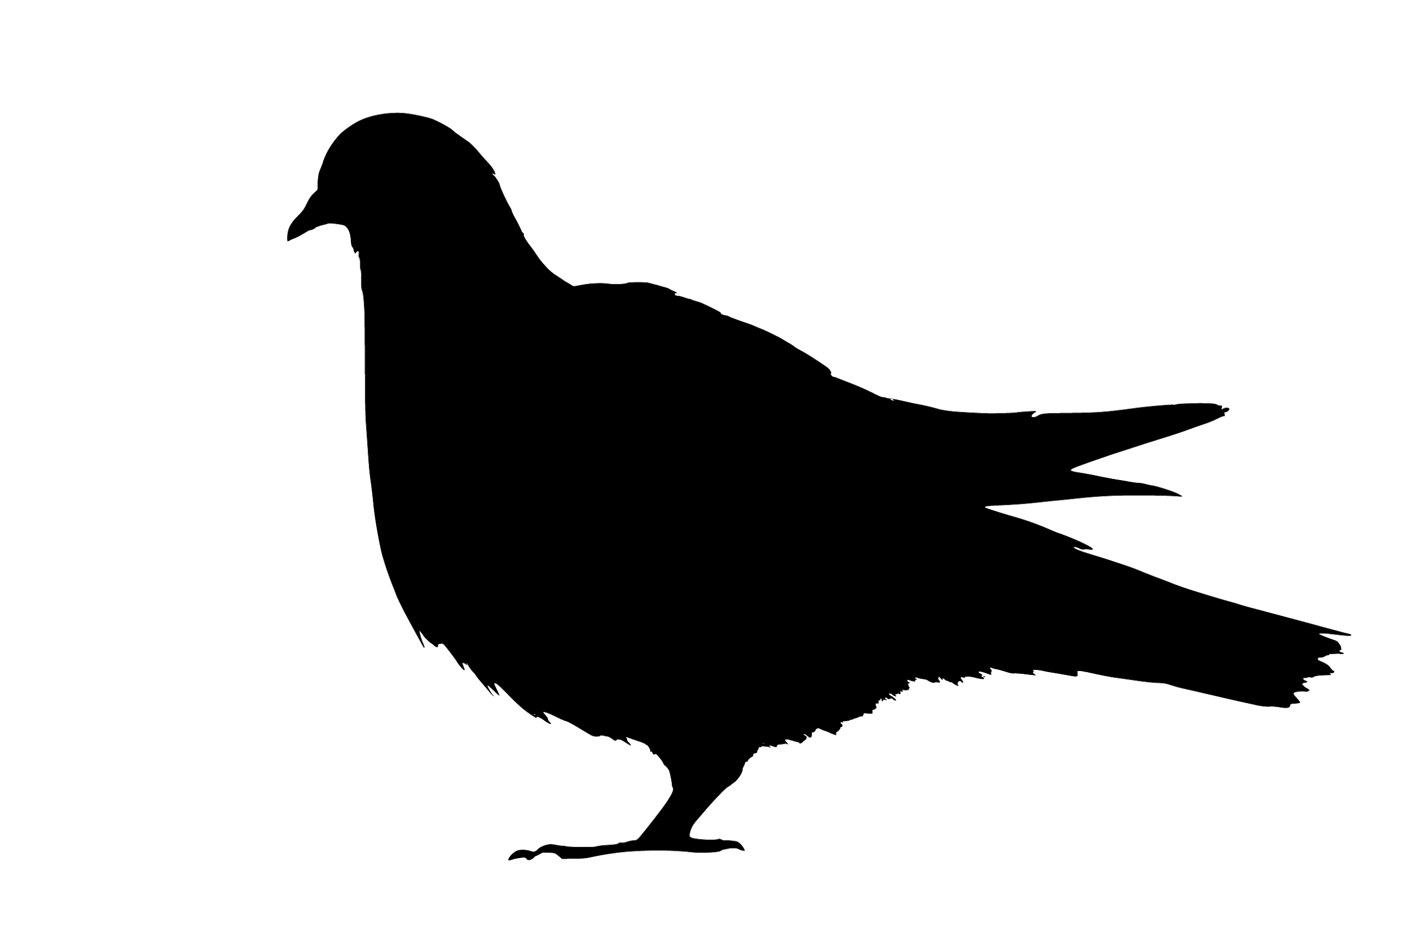
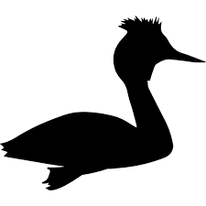
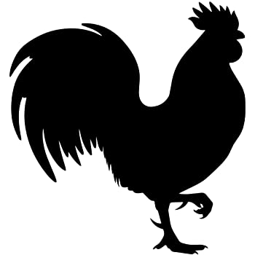
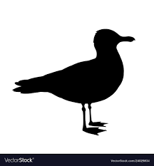
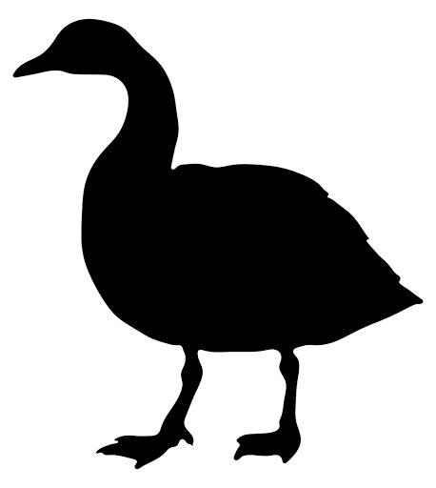



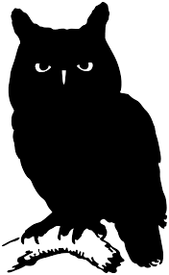
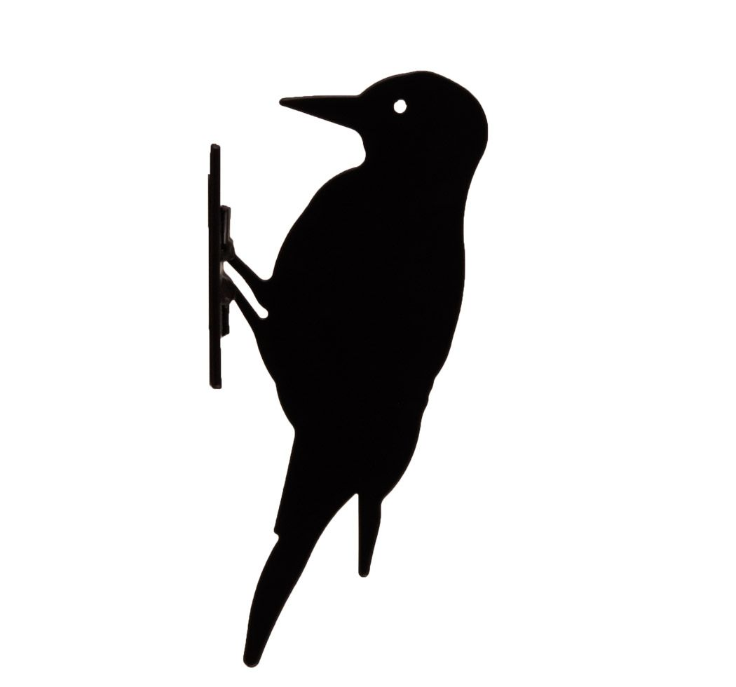

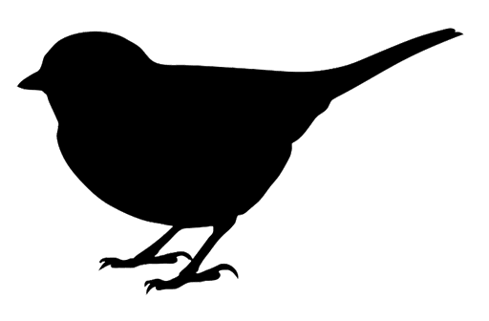
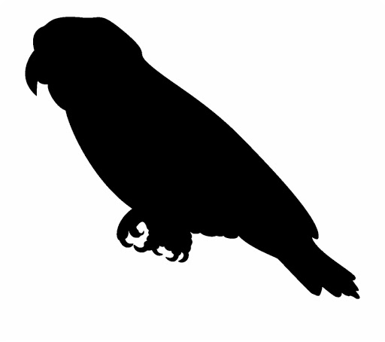
Crane
Pigeon
Grebe
Egret
Gull
Chicken
Goose
Cuckoo
Hummingbirds
Owl
Eagle
Woodpecker
Songbirds
Parrots
Falcon
Notes:
Here, I present to you the phylogenetic tree of all bird species used in this study. It might not be very clear and understandable, so let me show you some bird order to make it all a little clearer.
Now that we have a better understanding of the phylogenetic tree of birds, lets highlights the maximum pitch reached in each recordings

Slide 13
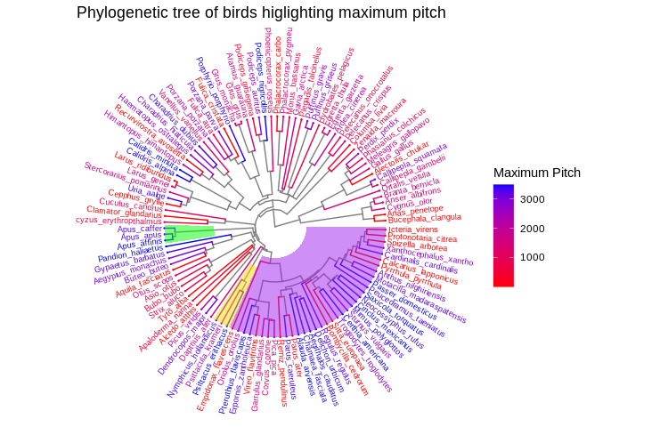
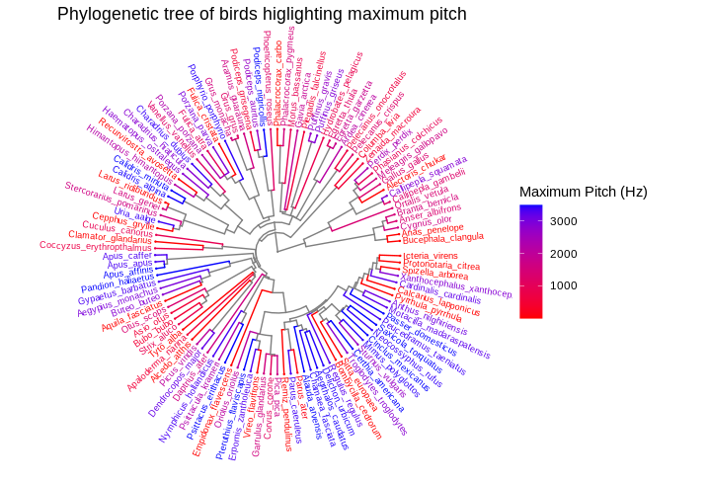
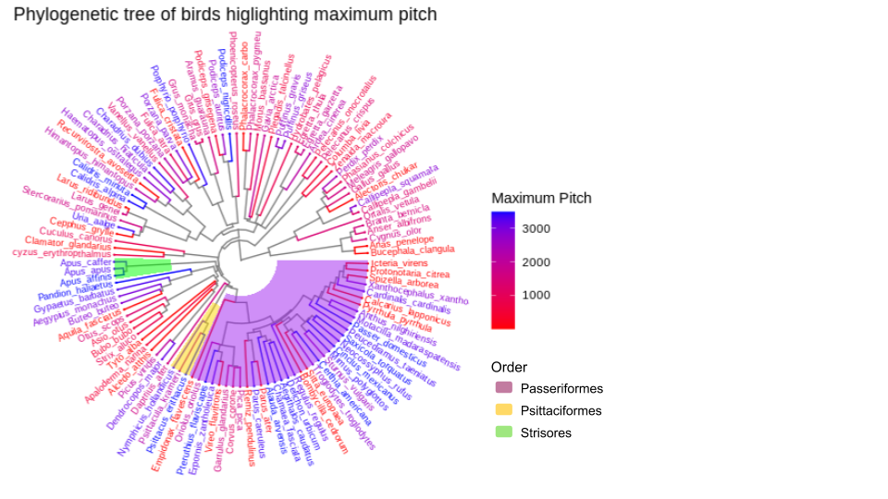
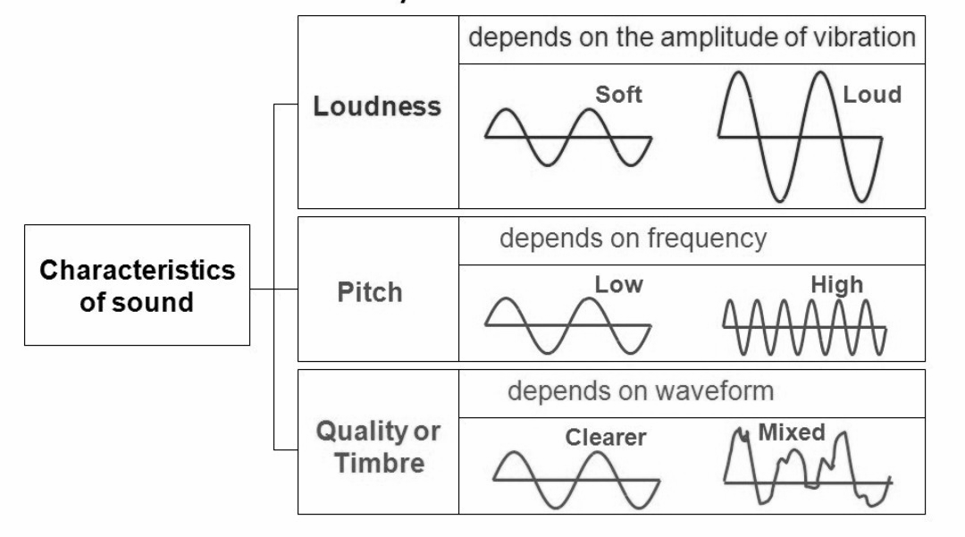
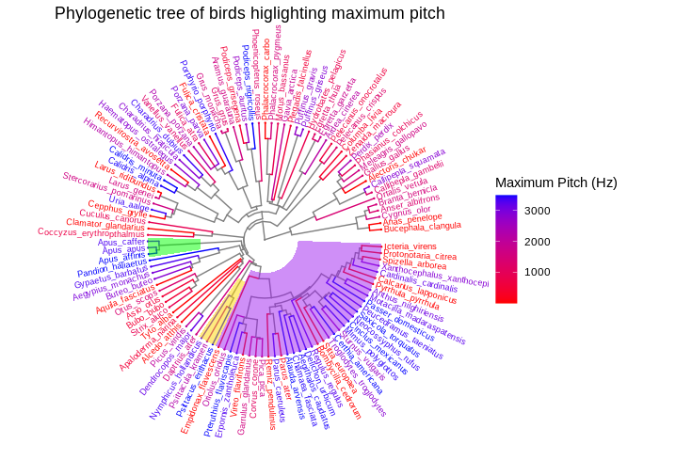
3488
1
Hummingbirds
Riede T, Olson CR. The vocal
organ of hummingbirds shows
convergence with songbirds.
2020
Caprimulgiformes
Songbirds
Parrots
Notes:
I plotted a phylogeny where I mapped the maximum pitch on each birds. For a quick recap, pitch is..
We see there are clusters that corresponds to birds order like songbird; Parrots; and Hummingbirds.
We observe that both parrots and songbirds, two sister groups, have higher maximum pitch than many other bird species.
From here, we can see that there might exist a kinship relationship between the maximum pitch repartition in the bird phylogenetic tree.
However, this theory does not explain why Hummingbirds have higher maximum pitch than other species because Hummingbirds are not closely related to parrots and songbirds, however their vocal organ shows convergence with the one of songbirds.
So, it might be the morphology of the vocal organs that explains higher maximum pitch in birds.
This phylogenetic study only allowed us to look at one variable at a time.

Slide 14
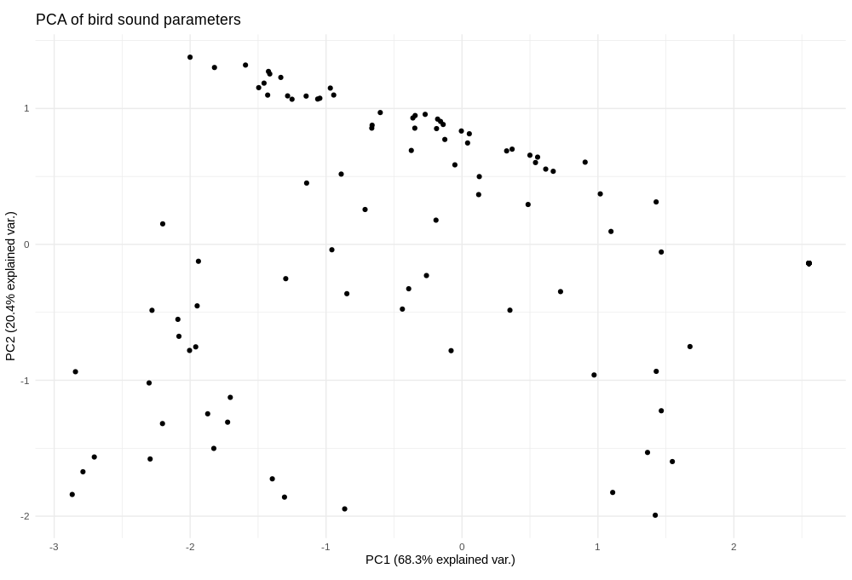
Notes:
So, I computted a PCA to not only look at one variable as I did in the tree, but to take in account multiple parameters at the same time. PCA is...
Because we saw some clades highlighted by the phylogenetic tree, I decided to showcase them in the pca as well

Slide 15
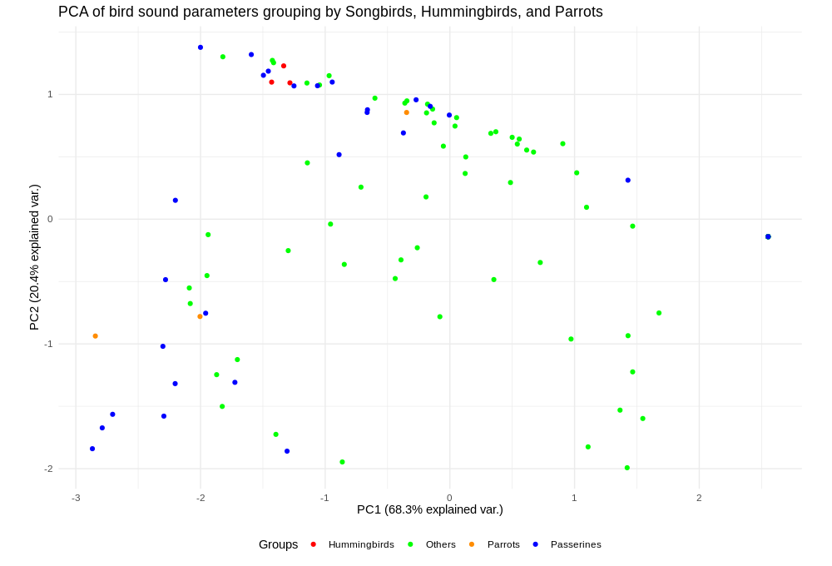
Notes:
So here we can see PCA of bird sound parameters grouped by differencing other birds from songbirds (in blue), parrots (in orange) and hummingbirds (in red). We notice that Songbirds also known as passerines encompass the other birds on the negative side of PC1.
How can we explain that?

Slide 16
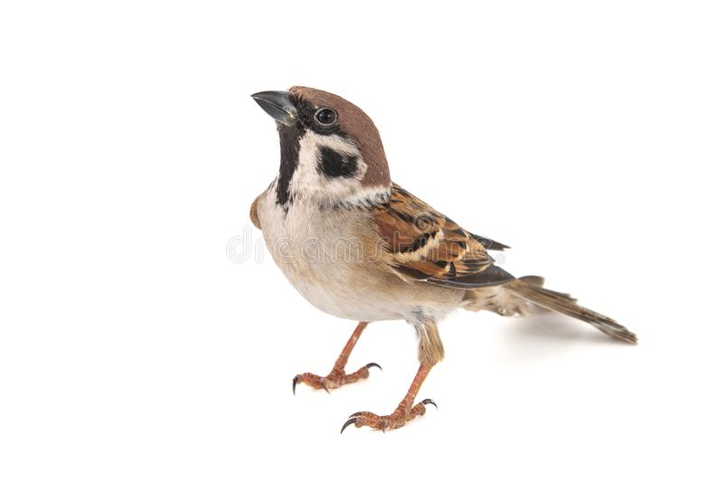
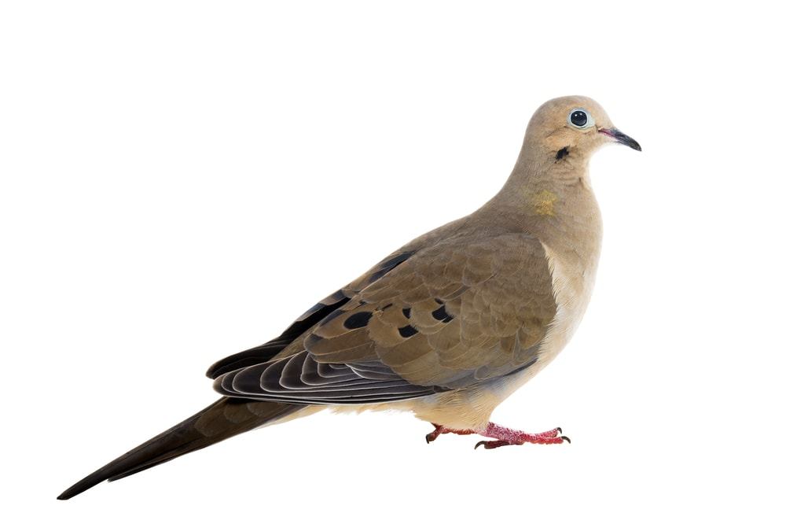
Min Loudness
House sparrow
Max Loudness
Max Pitch
Dove
Notes:
By adding the arrow we notice that the negative side of PC1 correlates with the maximum loudness and the maximum pitch. This mean that all point tending to the negative side of PC1 will have higher maximum loudness and pitch.
To showcase this to you, lets take bird example. Here, we have …
So, we can say that Songbirds represented in blue have higher maximum loudness and pitch. We observe that hummingbirds in red are positioned on the far up left and have also higher maximum loudness and pitch than the rest of birds. Parrots, in Orange, are more scattered but still on the negative side of PC1. They all have higher maximum pitch but their minimum loudness differ.
This pca explains over 90% of the variability.
In this pca, we saw that loudness was an important variability of the sounds,

Slide 17
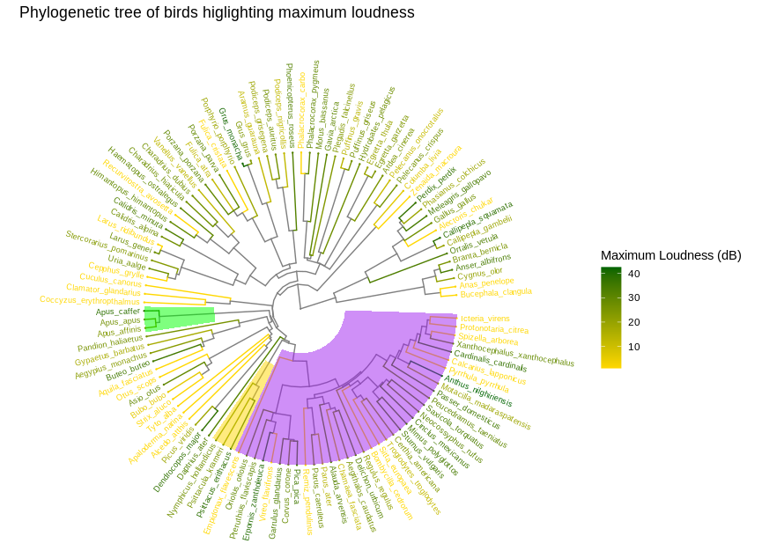
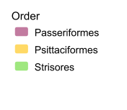
Hummingbirds
Caprimulgiformes
Songbirds
Parrots
Notes:
… so I plotted a phylogenetic tree highlighting maximum loudness. As a quick reminder, loudness…
In contrast with the tree highlighting pitch, wee see here no apparent link between the bird groups and their loudness.
We excpected that the mass had an influence on loudness, so, I looked at the influence of mass on sound parameters..

Slide 18
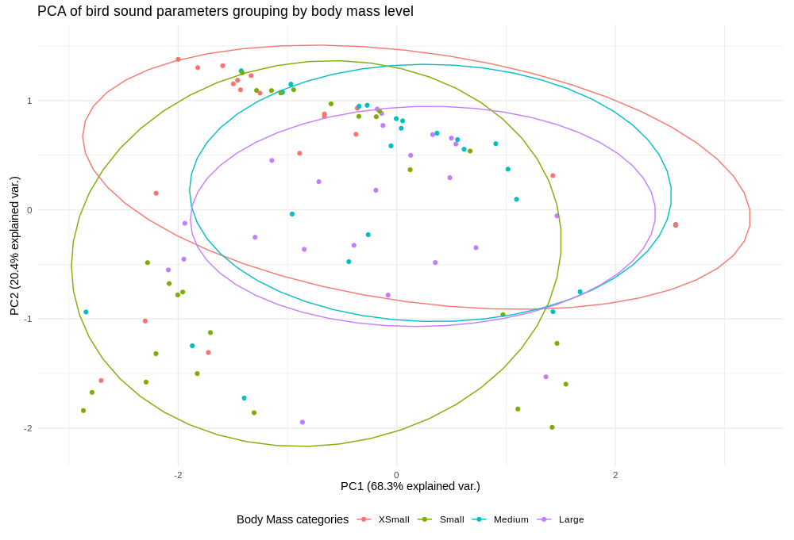
Min Loudness
Maximum Loudness
Max Loudness
Max Pitch
Minimum Loudness
5g to 32g | 32g to 177g | 177g to 759g | 759g to 1Kg
Notes:
And I was surprised to find that size seems to have an influence on sound parameters.
In this PCA of birds sound parameters, I grouped the bird by their mass into 4 categories (Xsmall, small, medium, and large) using quantiles technics. I also plotted the ellypse of each groups to improve the legibility of the graph.
We can see that medium and large birds ellipses are one on top of the others, this means that there is not much difference between large and medium bird in term of sound production. However, Small birds and Xsmall birds have higher maximum pitch and loudness than medium and large birds.
Xsmall birds have a wider range of loudness, they are the category that can produce both the higher maximum loudness and minimum loudness. This mean that they can sing louder and quieter than any other birds.
Small birds also seems to be able to sing at a higher maximum loudness than medium and large birds, however, there is a negative correlation between minimum loudness and small bird body mass. This mean that small birds are not able to sing quietly, but they can sing loudly.
Medium and large birds, on the other hand, are not able to reach high maximum loudness, however they can reach high minimum loudness.

Slide 19
Conclusion and Perspectives
5

Slide 20
They produce sounds with their SYRINX
How do birds vocalize ?
They modulate the sounds with their VOCAL TRACT
Does it depends on :
Introduction
Evolutionary history
Body size
Life style
Questions
Quantification with exploration of sound production in different families of birds
Influence of body size on sound parameters
Relationship between sound production and nocturnality
Methods
Phylogenetic comparative methods
PCA
PCA
PCA
Results
Loudness not linked to phylogeny
Max Pitch may be linked to phylogeny
Influence min and max loudness
Nocturnality influence max pitch and loudness
Notes:
so, to sum up...
To complete this study, further analytical analysis would be needed in addition of studying other parameters linked to lifestyle such as the influence of the living environment (arboreal or terrestrial)

Slide 21
They produce sounds with their SYRINX
How do birds vocalize ?
They modulate the sounds with their VOCAL TRACT
Does it depends on :
Introduction
Evolutionary history
Shape
Body size
Motion and deformation
Life style
Airflow
Questions
Quantification with exploration of sound production in different families of birds
Influence of body size on sound parameters
Relationship between sound production and nocturnality
Methods
Phylogenetic comparative methods
light video and X-ray videos
3D aeroaco--ustic model
PCA
PCA
PCA
Results
Loudness not linked to phylogeny
Max Pitch may be linked to phylogeny
Influence min and max loudness
Nocturnality influence max pitch and loudness
Notes:
The rest of the team will work on Motion and deformation of the vocal tract and the airflow. Rachel olson will work on X-ray videos showing the inside motion of the vocal tract while Alireza Kazemi will build a 3D aeroacoustic model. It is interesting because sound is produced by air vibration.

Slide 22
They produce sounds with their SYRINX
How do birds vocalize ?
They modulate the sounds with their VOCAL TRACT
Does it depends on :
Introduction
Evolutionary history
Shape
Body size
Motion and deformation
Life style
Airflow
Questions
Quantification with exploration of sound production in different families of birds
Influence of body size on sound parameters
Relationship between sound production and nocturnality
Methods
Phylogenetic comparative methods
light video and X-ray videos
3D aeroaco--ustic model
PCA
PCA
PCA
Results
Loudness not linked to phylogeny
Max Pitch may be linked to phylogeny
Recording cage / Bird video
Influence min and max loudness
Nocturnality influence max pitch and loudness
Notes:
I haven't mentioned it earlier but I also worked on developing an experimental protocol to record vocalising bird. However, in contrast of what Rachel Olson will do, the protocol I designed is to film birds in the visual spectrum to look at the outside, not in the X-ray spectrum.

Slide 23

Notes:
To illustrate this, let me show you this short and very informative video.
This is a video of my myna that i took at the beginning of my internship.
We can clearly see a visual difference between low and high pitch.

Slide 24
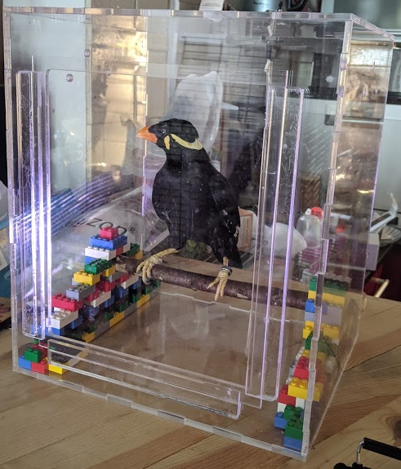
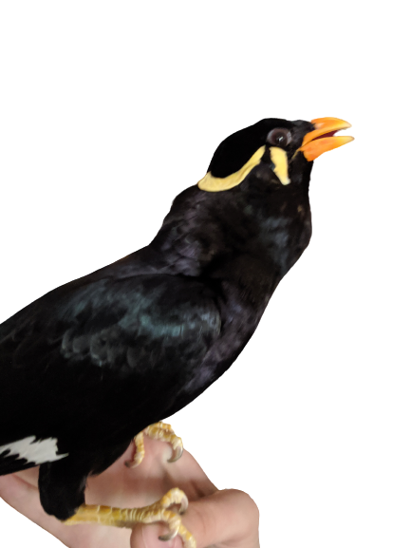
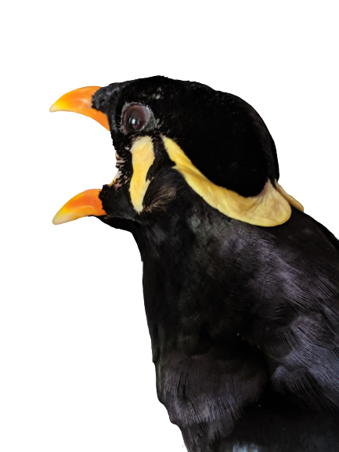
LOW PITCH
HIGH PITCH
Notes:
From there, we tried to develop an experimental protocol to record vocalising bird in order to quantify the movements between the syrinx structures and the rest of the vocal tract in order to convey a biomechanical study on bird vocalisation.
So, I designed a recording cage for this protocol that I designed entirely in 3D, using a laser cutter at the Maker lab! Here we can see a picture of a recording test that I did with my myna.

Slide 25

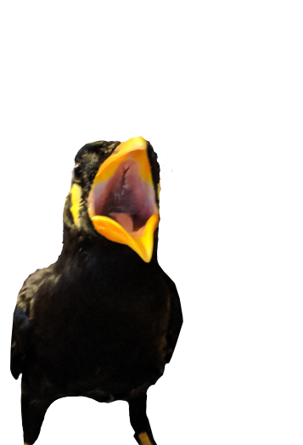
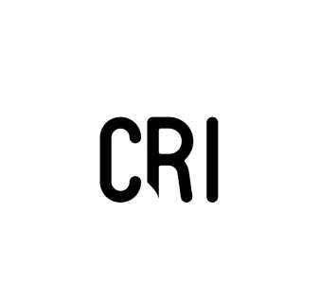
Acknowledgments
6
Notes:
I would like to thanks Pauline Provini for being an excellent supervisor to me, and Rachel Olson. They both welcomed me with such kindness and helped me during this internship. I am really sad that the internship is approaching the end, and I am so grateful to have had this wonderful opportunity. So once again, THANK YOU ! And I hope to get to learn more about the new member of the team, Ali.
Thanks for listening

Slide 26
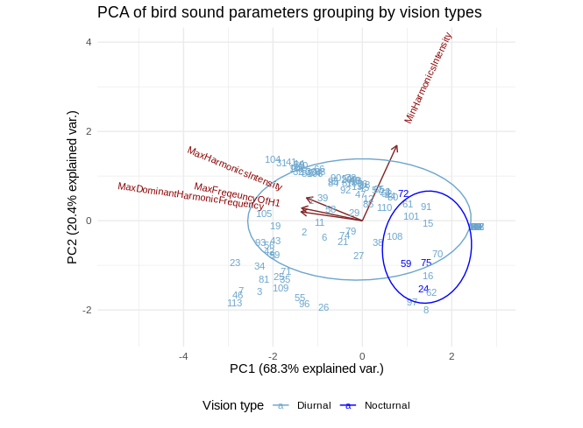

Slide 27
They produce sounds with their SYRINX
How do birds vocalize ?
They modulate the sounds with their VOCAL TRACT
Does it depends on :
Biomechanics of the vocal tract
Airflow of the vocal system
Other parameters
Size of the birds
Shape of the syrinx
Evolutionary history of the species
Record birds during vocalisation in visible spectrum
Record birds during vocalisation in X-rays spectrum
PCA
PCA
Quantification with exploration of sound production in different families of birds
Development of an experimental protocol
Cineradiography
3D aeroacoustic model
Nocturnality influence max pitch and loudness
Influence minimum loudness
Phylogenetic trees coloured with different acoustic parameters
Big picture
Recording cage
Bird video
Process
Max Pitch may be linked to phylogeny
Loudness not linked to phylogeny
Results
Final observation/output
Notes:
what parameters influence the sound?

